Slide 1
Spontaneous Proteins Y
Dillon Britt, Benjamin Carpenter, and Malachi Partlow

Slide 2
Problem Statement
How long would it take for a DNA sequence to spontaneously arrange itself into the right order to produce even a simple oligopeptide

Slide 3
Plan
Understand how DNA becomes a peptide.
Create a model that converts DNA to RNA
Then have the model convert RNA to Amino Acids
Let the user pick how long the DNA sequence is or pick the DNA sequence
Take the user’s input and test it with random sequences until it matches the original
Print Results

Slide 4
How DNA Actually Becomes a Peptide

Slide 5
DNA
DNA is composed of building blocks called nucleotides consisting of 1 of 4 nitrogen bases.
adenine (A), thymine (T), guanine (G) and cytosine (C)

Slide 6
RNA
RNA is formed from DNA (This is known as transcription)
The T molecule from DNA doesn’t exist in RNA so it uses uracil (U)
adenine (A), cytosine (C), guanine (G), and uracil (U)

Slide 7
Amino Acids
The Amino acids are actually what makes up a peptide.
Amino acids are organic compounds

Slide 8
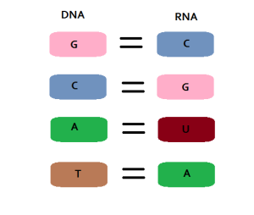
Transcription of DNA to RNA
This is the code of how DNA is actually transcribed into RNA using a codon chart
If you have the DNA strand GCA CTA ACT
The RNA output would be CGU GAU UGA

Slide 9
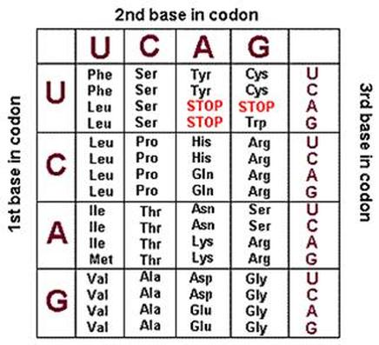
Codon Chart
A codon is a segment of three letters for DNA/RNA. The purpose of a codon chart is to tell which Amino acids go where according to the RNA strand.
The RNA from the previous slide: CGU GAU UGA
The Amino Acids would be, Arg-Asp. If it hits stop, it . means it’s done.

Slide 10
Models
For our models we made two programs in different languages. One in C++ and the other in Python.

Slide 11
Reflections
Are these results accurate?
What assumptions were made?
What did we learn?
What would we do differently next time?
What would you say to future computational thinkers?

Slide 12
Sources
http://www.livescience.com/37247-dna.html
http://ghr.nlm.nih.gov/handbook/basics/dna
http://www.nature.com/scitable/definition/ribonucleic-acid-rna-45
http://jacksonstrickland.weebly.com/codon-chart.html (Codon chart)
https://www.shsu.edu/~agr_www/documents/mRNAcodonchart.pdf (Codon Chart)
https://youtu.be/VYbqG2NuOo8

